Slide 1



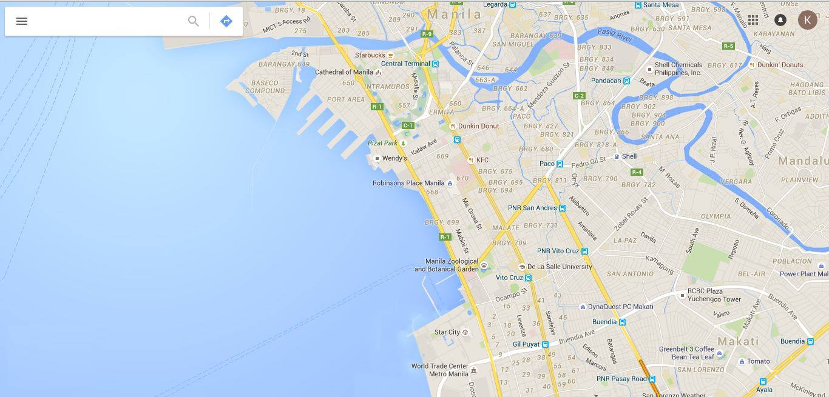


Aegis
Infographics
Contact Numbers
Login

Slide 2

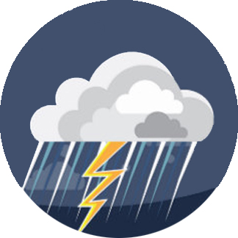
Aegis
Infographics
Contact Numbers
Login

Slide 3

Aegis
Infographics
Contact Numbers
Login

Slide 4
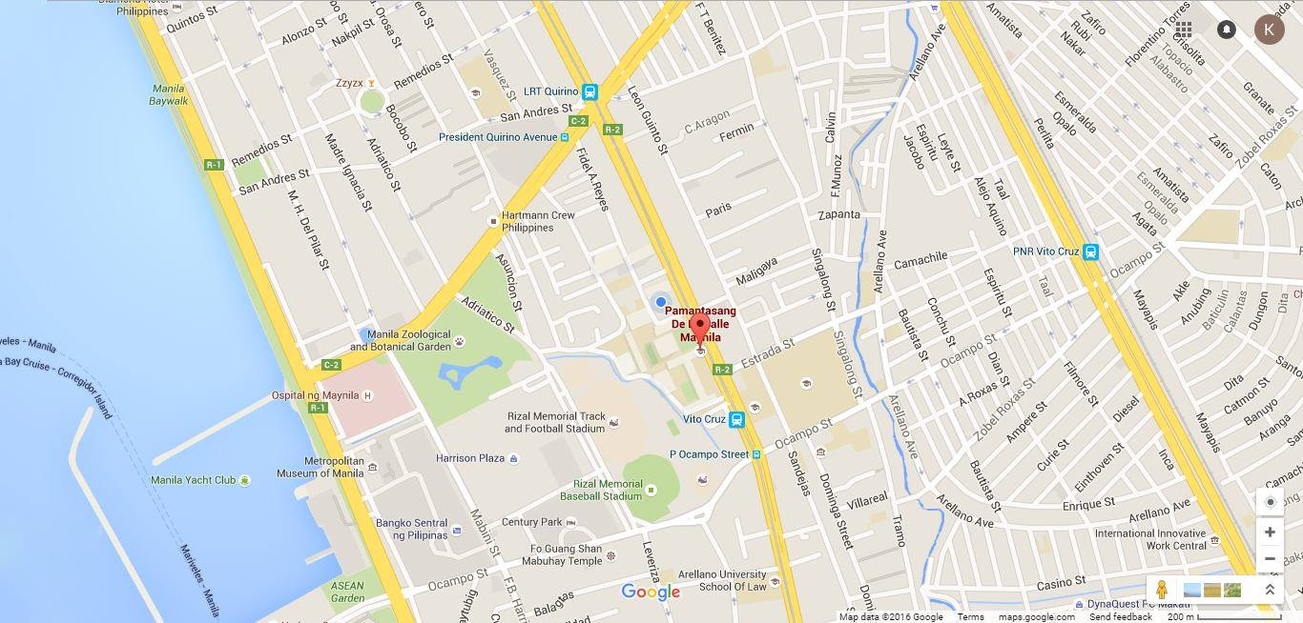

Aegis
Infographics
Contact Numbers
Login

Slide 5

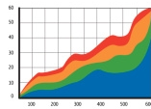
Aegis
Infographics
Contact Numbers
Login
Analytics
Flood History:
Risk Score:
Your area has a
69%
of getting flooded

Slide 6
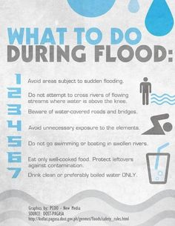
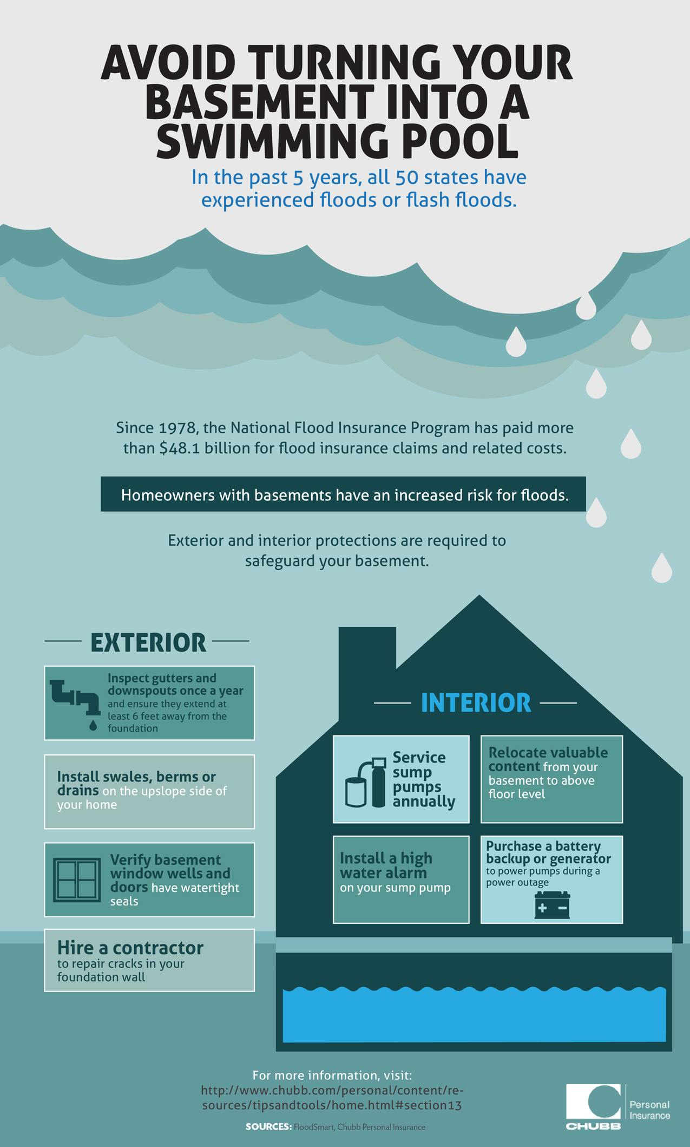
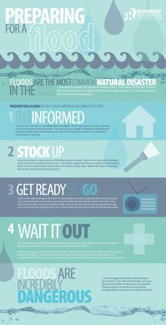
Aegis
Infographics
Contact Numbers
Login
of getting flooded

Slide 7

Aegis
Infographics
Contact Numbers
Login
Login
Username
Password
Create an account
Login

Slide 8
Aegis
Infographics
Contact Numbers
Login
Sign Up
Username
Password
Create an account
Sign Up

Slide 9
Aegis
Infographics
Contact Numbers
Login
Contact the following for flood related matters:
NDRRMC hotlines:
(02) 911-1406
(02) 912-2665
(02) 912-5668
(02) 911-1873
PAGASA hotline
(02) 433-8526
Bureau of Fire Protection (NCR)
117
(02) 729-5166
(02) 410-6319 (Regional Director, Information Desk)

Slide 10



Aegis
Infographics
Contact Numbers
Login
NDRRMC
For damage assessment and consolidated reports on government action

Slide 11

Aegis
Infographics
Contact Numbers
Login

